Slide 1
Copyright en academische vrijheid
Masterclass copyright
Chris HJ hartgerink
KNAW, 31 maart 2016

Slide 2
Copyright en academische vrijheid?

Slide 3
Copyright ←→ onderzoek

Slide 4
Copyright ←→ archief onderzoek

Slide 5
Copyright ←→ text analyse

Slide 6
Copyright ←→ Text- and Data Mining

Slide 7
Wat doen onderzoekers?

Slide 8
Geven alle auteursrechten weg*
*Behalve bij Open Access bladen.

Slide 9
It is the policy of the APA to own the copyrights to its publications, and to the contributions contained therein, in order to protect the interests of the Association, its authors, and their employers, and at the same time to facilitate the appropriate reuse of this material by others.

Slide 10
Gevolgen?

Slide 11
Belemmert hergebruik

Slide 12
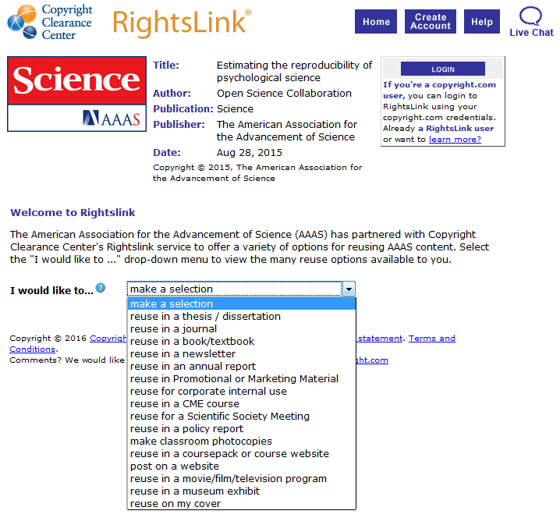

Slide 13
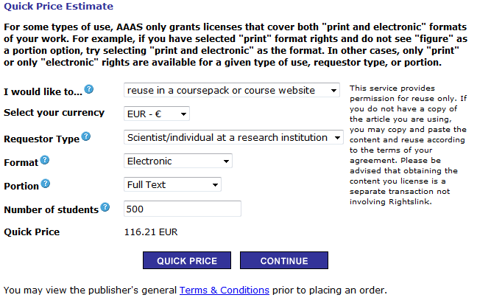

Slide 14
Analyseren artikel vereist kopie artikel (= download)

Slide 15
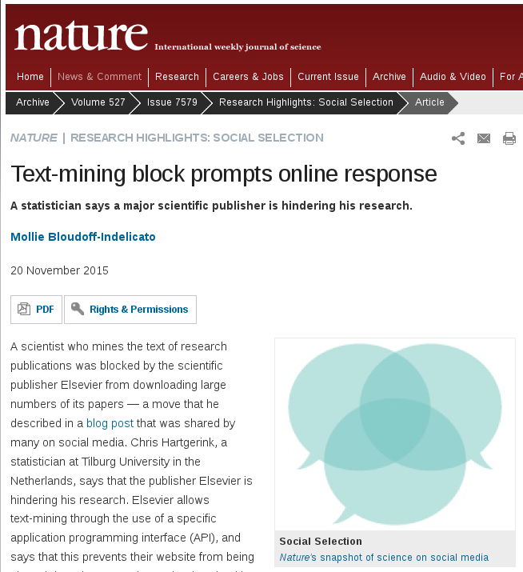
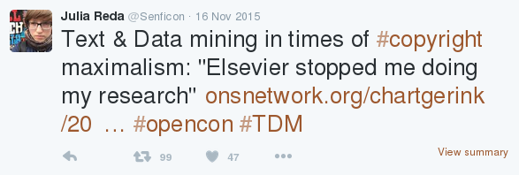

Slide 16
Copyright belemmert hergebruik

Slide 17
Copyright belemmert onderzoek

Slide 18
It is the policy of the APA to own the copyrights to its publications, and to the contributions contained therein, in order to protect the interests of the Association, its authors, and their employers, and at the same time to facilitate the appropriate reuse of this material by others.

Slide 19
It is the policy of the APA to own the copyrights to its publications, and to the contributions contained therein, in order to protect the interests of the Association, its authors, and their employers, and at the same time to facilitate the appropriate* reuse of this material by others. *as defined by the publisher

Slide 20
Als onderzoekers auteursrechten behouden

Slide 21
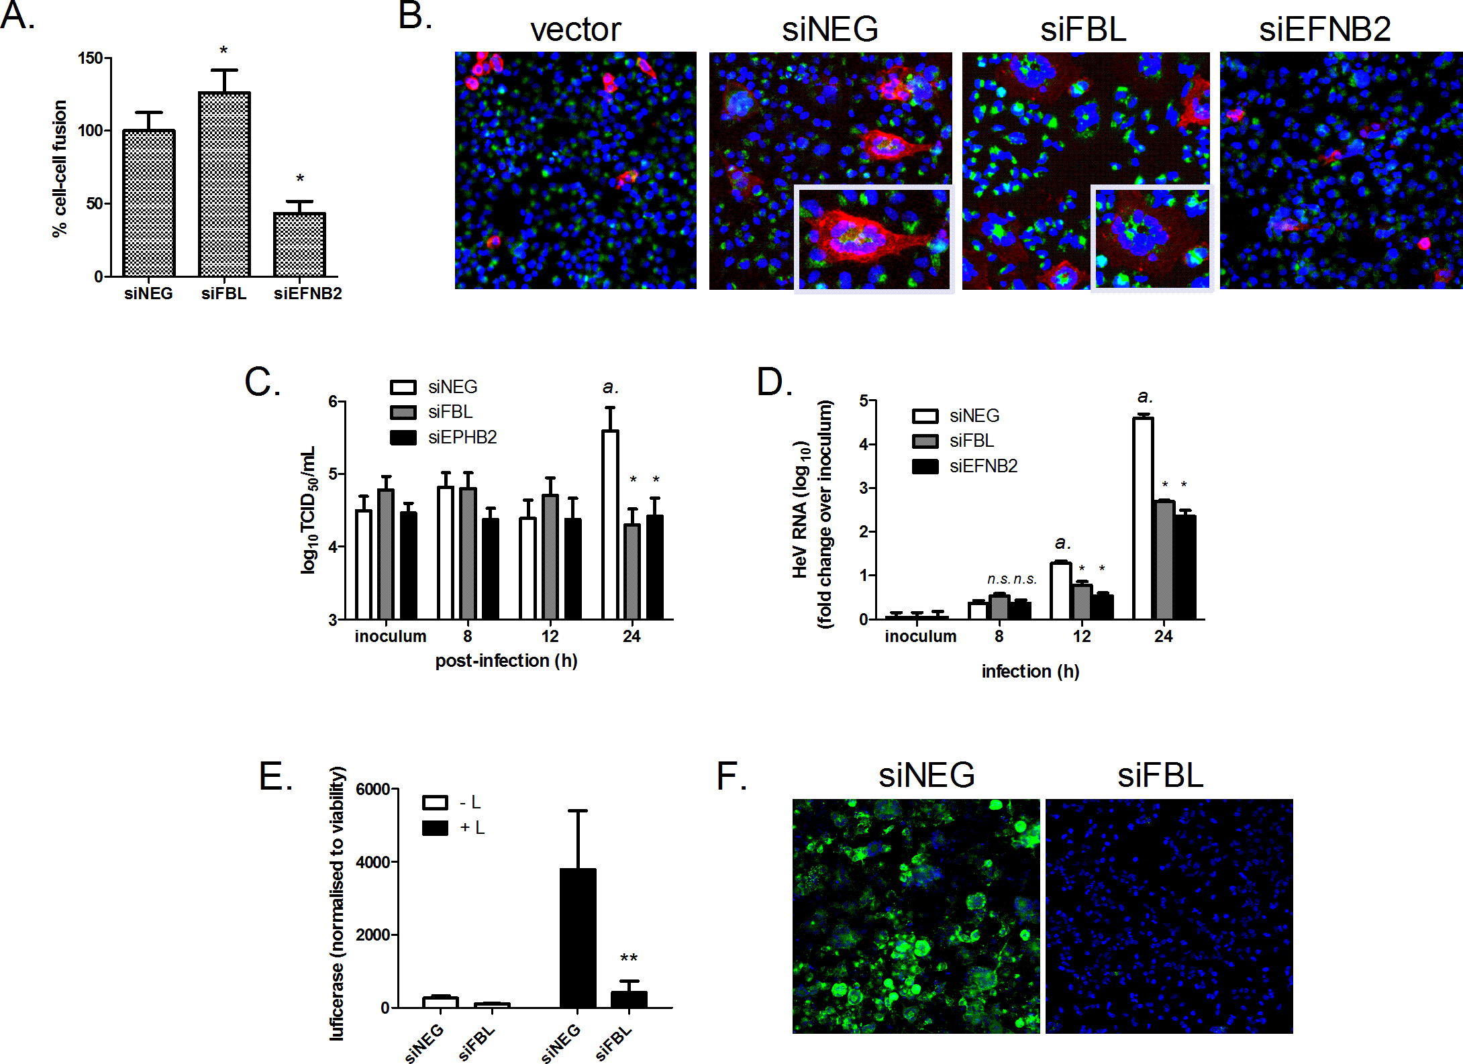
Deffrasnes et al. (2016). PLOS Pathogens, doi:10.1371/journal.ppat.1005478

Slide 22
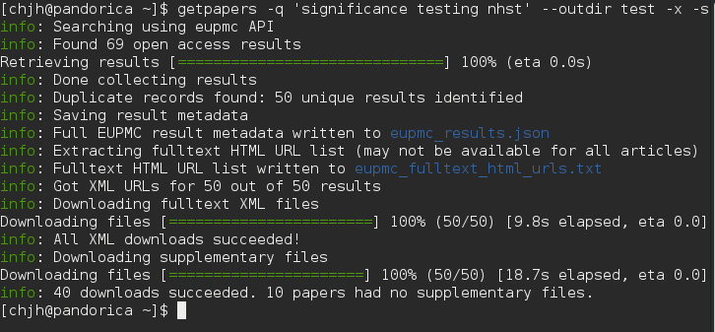

Slide 24
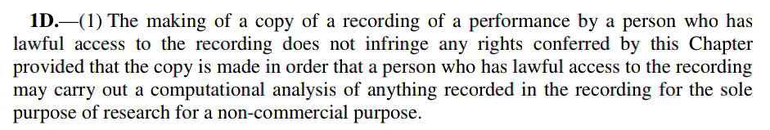

Slide 26
UK = ✓

Slide 27
UK = ✓ Onderzoek > copyright

Slide 28
NL = X

Slide 29
NL = X Onderzoek < copyright

Slide 30
Maar landschap verandert

Slide 31
Open Access standaard

Slide 32
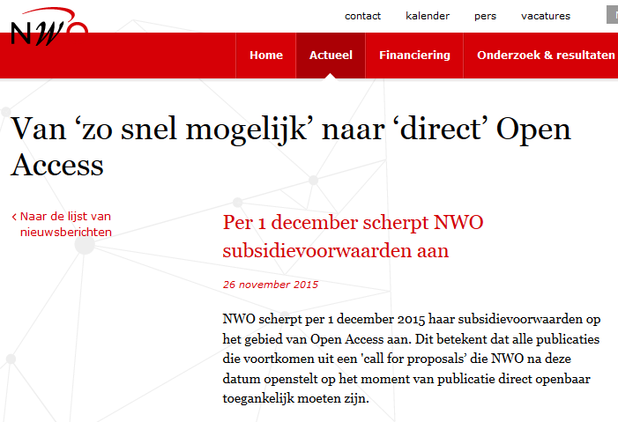

Slide 33
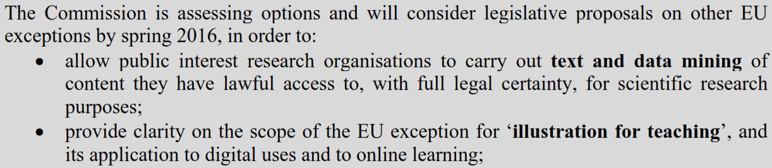

Slide 34
September: EU-brede copyright uitzondering onderzoek?

Slide 35
September: EU-brede copyright uitzondering onderzoek?
Waarschijnlijk!

Slide 36
Goede hoop voor academische vrijheid op copyright vlak. ☺

